Slide 1
National FFA Organization
Siegel FFA Chapter
Fall 2016

Slide 2
What is FFA?
FFA is an intercurricular student organization for those interested in agriculture and leadership.
FFA is for students who aspire to careers as teachers, doctors, scientist, business owners and more.
Agriculture is a component of everything we do

Slide 3
What is FFA?
An organization of over 620,000 agricultural education students from all 50 states plus Puerto Rico & the Virgin Islands are in FFA

Slide 4
FFA History
1917 Smith-Hughes Act
Names after a congressmen and a senator from Georgia
Provided federal funding for the establishment of Vocational Agriculture in public high schools
Notes:
Ag education all started with the 1917 Smith-Hughes Act
but what this act did was allo

Slide 5
1928 – Future Farmers of America
FFA was established
Future Farmers of America
The 1st convention was held in the Hotel Baltimore in Kansas City, Missouri.
33 delegates
18 states
Dues were .10 cents

Slide 6
1928 - FFA
FFA was formed from the Future Farmers of Virginia
Henry Groseclose of Virginia became know as the “Father of FFA”
Leslie Applegate of New Jersey became the 1st National FFA President

Slide 7
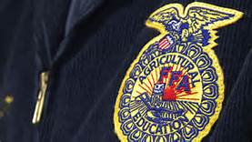
FFA
Dr. C.H. Lane became the 1st National Advisor.
The National FFA Convention was held in Kansas City from 1928 to 1998.

Slide 8
FFA
1930
FFA Creed is written by E.M. Tiffany.
It was revised at the 38th and 63rd Conventions.
1930
FFA Colors were adopted
National Blue
Corn Gold

Slide 9
FFA Creed
I believe in the future of agriculture, with a faith born not of words but of deeds - achievements won by the present and past generations of agriculturists; in the promise of better days through better ways, even as the better things we now enjoy have come to us from the struggles of former years.

Slide 10
Creed
I believe that to live and work on a good farm, or to be engaged in other agricultural pursuits, is pleasant as well as challenging; for I know the joys and discomforts of agricultural life and hold an inborn fondness for those associations which, even in hours of discouragement, I cannot deny.

Slide 11
Creed
I believe in leadership from ourselves and respect from others. I believe in my own ability to work efficiently and think clearly, with such knowledge and skill as I can secure, and in the ability of progressive agriculturists to serve our own and the public interest in producing and marketing the product of our toil.

Slide 12
Creed
I believe in less dependence on begging and more power in bargaining; in the life abundant and enough honest wealth to help make it so--for others as well as myself; in less need for charity and more of it when needed; in being happy myself and playing square with those whose happiness depends upon me.

Slide 13
I believe that American agriculture can and will hold true to the best traditions of our national life and that I can exert an influence in my home and community which will stand solid for my part in that inspiring task.

Slide 14
Creed
2014 Ohio FFA State Creed speaking winner - Jordan Richards from Anna FFA Chapter
https://www.youtube.com/watch?v=KifMwKSjYOM
Extra Credit: Say the in front of the class on September 7
Leadership Development Event: Creed
Date: TBA

Slide 15
Creed Assignment
You will have to remember the creed and fill in the blanks.
You will be tested on this on each paragraph these days:
P1: August 19
P2: August 23
P3: August 26
P4: August 31
P5: September 8

Slide 16
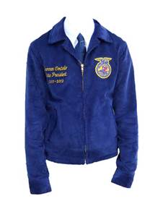
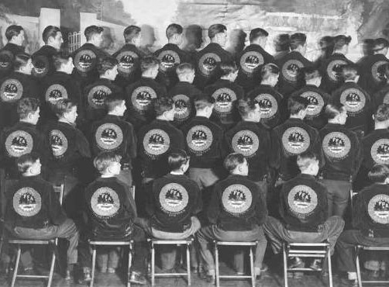
FFA Jacket
1933
FFA jacket is designed by Dr. Gus Lintner of Ohio.

Slide 17
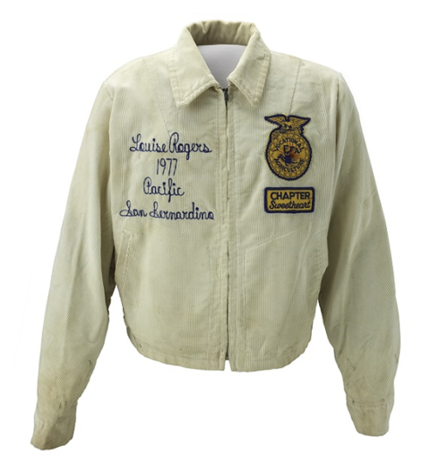
Fun Fact
The white FFA Jacket was reserved for the
Chapter Sweetheart

Slide 18
FFA History
1939
FFA purchases 28.5 acres of land in Alexandria, Virginia; which was part of George Washington’s estate at Mt. Vernon.
This is where Washington Leadership Conference is held today
1944
National FFA Foundation formed.
Raises money for FFA activities and scholarships.
1948
National FFA Supply service formed.
https://shopffa.org/products
Notes:
Today 2.2 million dollars in scholarships is given away each year, at that money could be yours. I recived one when i was in high school

Slide 19
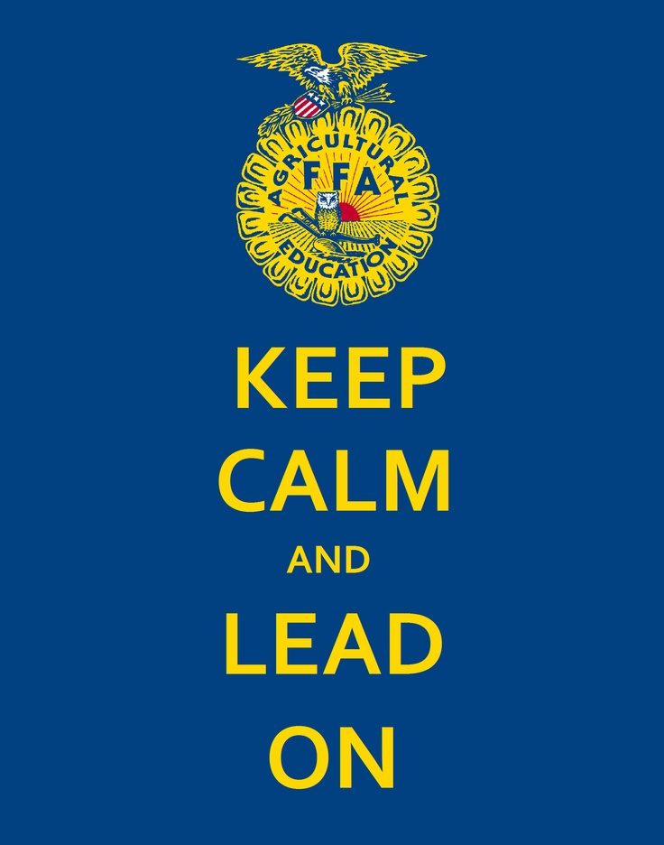
FFA History
1950
Public Law 740
Gave the FFA a federal charter.
Where there is a high school agriculture program, there must be a FFA chapter.

Slide 20
Public Law 740
Agriculture Education is based on three components
Classroom and laboratory instruction
FFA
Supervised Agricultural Experience (SAE)
Programs that allow you to apply knowledge and skills through experiential, service and work based learning opportunities.

Slide 21
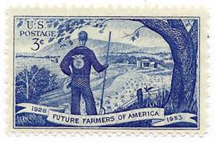
FFA History
1953
U.S. Postal Service issues a commemorative stamp for the FFA’s Silver (25th) Anniversary.

Slide 22
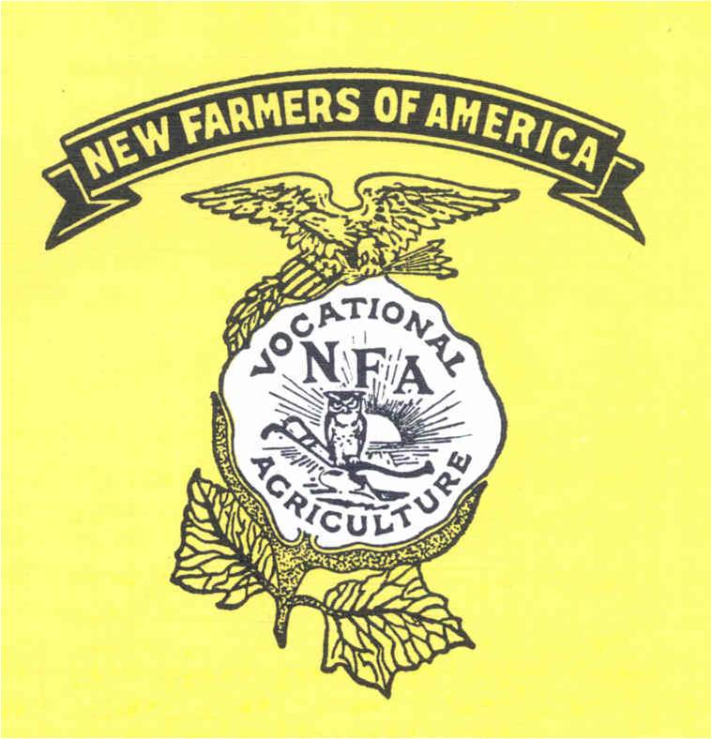
FFA History
1958
First National FFA Center in Alexandria, Virginia is dedicated.
1965
FFA and the New Farmers of America merge.

Slide 23
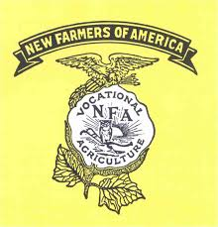
New Farmers of America
Organization for African-American males in high school agriculture classes.
Formed in Virginia…
Like the FFA.
Merged with the FFA in 1965

Slide 24
New Farmers of America
Dr. H.O. Sargent was a co-founder of the NFA.
Today the FFA gives an award in his memory to honor those that promote diversity in agriculture.

Slide 25
FFA History
1969
Females are admitted into the FFA.
1971
National FFA Alumni Association was founded.

Slide 26
FFA History
1988
Future Farmers of America changes its name to the National FFA Organization.
Why do you think they changed the name?
1989
National Future Farmer Magazine changes its name to FFA New Horizons.

Slide 27
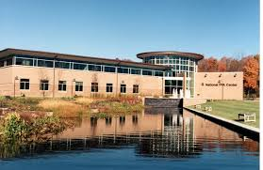
FFA History
1998
The National FFA Center moves to Indianapolis, Indiana.

Slide 28
FFA History
1999
National FFA Convention moves to Louisville, Kentucky.
This is the 1st time the convention is held outside Kansas City, Missouri.
Now National FFA Convention alternates between Indianapolis, Indiana to Louisville, Kentucky.
https://www.youtube.com/watch?v=-akdYlYiLO0

Slide 29
Conventions
National Convention
State Convention
Gatlinburg, TN

Slide 30
Awards

Slide 31
FFA Degrees
Discovery Degree
Greenhand Degree
Chapter Degree
State Degree
American Degree

Slide 32
Discovery Degree
Enrollment in a Grade 7 or 8 Agricultural Course
Payment of Membership Dues
Participation in at least one FFA Activity Outside of Classroom
Awareness of Agricultural Opportunities
Familiarity with the Chapter’s Program of Activities

Slide 33
Greenhand Degree
The first FFA degree is the Greenhand
Greenhands receive a pin in the shape of the FFA emblem made of bronze

Slide 34
Greenhand Continued…
Be enrolled in Agricultural Education
Have satisfactory plans for a SAE
Explain the FFA creed, motto, salute, and mission statement
Describe the FFA emblem and colors
Have a knowledge of the Code of Ethics and proper use of the jacket
Have a knowledge of the FFA
Own or have access to a FFA Manual and FFA Student Handbook

Slide 35
Chapter Degree
The second degree, which is given at the local level, is the chapter degree.
Chapter degree recipients receive a pin in the shape of the FFA emblem made of silver.

Slide 36
Chapter Degree
Have the Greenhand Degree
Completed 180 hours (or equivalent) of agricultural education
Have in operation an approved SAE program
Earned $150 from the SAE or worked 45 hours or a combination thereof
Have plans for continued SAE growth

Slide 37
Chapter Degree
Help conduct 3 official chapter functions found in the Program of Activities
Lead a group discussion for 15 minutes
Demonstrate 5 parliamentary procedures
Submit a written application for the degree
Show progress in the FFA individual achievement awards program
Have a satisfactory scholarship record

Slide 38
State Degree
The third degree, given at the state convention, is the State degree.
State degree recipients receive a pin in the shape of the FFA emblem made of gold.

Slide 39
State Degree
Have received the Chapter FFA Degree
Have been an active FFA member for 2 years
Completed 360 hours (or equivalent) of agricultural education
Earned and invested $1000 or worked at least 300 hours or combination thereof

Slide 40
Sate Degree
Demonstrate leadership ability by:
(a) Performing 10 procedures of parliamentary law
(b) Giving 6 min. speech on agriculture or FFA
(c) Serving as an officer, committee chairperson, or member of chapter committee

Slide 41
State Degree
Have participated in planning and completion of chapter Program of Activities
Have participated in 5 FFA activities above chapter level
Have a satisfactory scholarship record

Slide 42
American Degree
Have received the State FFA Degree
Have been an active FFA member for the past 3 years
Have record of satisfactory participation
Completed 540 hours (or equivalent) of agricultural education
Have graduated from high school

Slide 43
American Degree
Have in operation an approved SAE program
Earned $7,500 from the SAE or earned and invested $1,500 and worked 2,250 hours
Have record of outstanding leadership abilities and community involvement
Achieved a scholastic record of “C” or better

Slide 44
SAE -- Supervised Agriculture Experience (programs)
An SAE is a year-round developmental program that can be made up of multiple enterprises and activities, development of supplemental skills, learning activities and improvement projects impacting the student’s SAE, home, school or community.

Slide 45
SAE / Proficiency Award
An award presented by the National FFA to recognize excellence in a SAE program.
There are over 40 areas of agriculture for which awards are available.

Slide 46
SAE / Proficiency Awards
Proficiency award winners are recognized at the:
local level
district, federation and/or area level
state level
national level

Slide 47
Types SAE
Exploratory
Learn about the big picture of agriculture and its many related careers.
Agriscience Research and Experimentation
Involve planning and conducting a scientific experiment based on hypothesis and the use of the scientific method of investigation on the hypothesis. This may include qualitative, quantitative, experimental, descriptive and quasi- experimental research.

Slide 48
Types of SAE
Ownership/Entrepreneurship
A student-owned enterprise where the student assumes responsibility for all financial and management decisions for the successful completion of the project or activity.
Placement
A student works for an agriculture-related business or individual, either for pay or for the experience
These two are the proficiency categories
https://www.ffa.org/SiteCollectionDocuments/proficiency_awards_award_area_descriptions.pdf

Slide 49
Types of SAE’s
Research/Experimentation
Where a student conducts research using the scientific process Agriculture is a science-based industry and there are limitless opportunities for research-based experiences.
School Based Enterprise
Where a student-managed, entrepreneurial operation in a school setting that provides good or services that meet the needs of an identified market. Replicate the workplace environment as closely as possible
Service Learning
Where a student-managed a series activity where students are in the development of a needs assessment, planning the goals, objectives and budget, implementation of the activity, promotion, and evaluation/reflection of a chosen project.

Slide 50
FFA Motto
Learning to Do,
Doing to Learn,
Earning to Live,
Living to Serve

Slide 51
FFA Mission Statement
FFA makes a positive difference in the lives of students by developing their potential for premier leadership, personal growth and career success through agricultural education.

Slide 52
FFA Salute – The Pledge of Allegiance
“I pledge allegiance to the Flag of the United States of America and to the Republic for which it stands, one Nation under God, indivisible, with liberty and justice for all.”

Slide 53
FFA Emblem
Each part of the emblem has a unique meaning.
There is a connection of the emblem parts to the offices of the FFA Chapter
There is a connection to the officers’ and advisor’s part in the opening and closing ceremony

Slide 54
FFA Emblem – Rising Sun
Rising Sun
Meaning: Dawn of a new day in Agriculture
President

Slide 55
FFA Emblem -- Plow
Meaning: Labor and tillage of the soil
Plow
Vice President

Slide 56
FFA Emblem -- Owl
Meaning: Wisdom and knowledge
Owl
Advisor

Slide 57
FFA Emblem -- Corn
Cross section of an ear of corn
Meaning: Corn is a foundation crop as it can be grown in every state and territory and it is a production item that unifies
Secretary

Slide 58
FFA Emblem – Eagle (including arrows and shield)
Meaning: National Scope of the organization, a reminder of our freedom and ability to explore new horizons
Eagle

Slide 59
FFA Emblem –
FFA & Agricultural Education
The words: FFA & Agricultural Education
Meaning: Symbolize learning and leadership

Slide 60
Officer Positions and Their Symbol
President Rising Sun
Vice President Plow
Secretary Ear of Corn
Treasurer George Washington
Reporter Flag
Sentinel Shield of Friendship/Hand Shake
Advisor Owl

Slide 61
Opening and Closing Ceremonies
Print out
Leadership Development Event

Slide 62
Girls Official Attire
Black skirt - Skirt is to be at least knee length, hemmed evenly across the bottom, with a slit no longer than 2 inches above the knee, excluding the kick pleat
White collared blouse & Official FFA blue scarf
Black dress shoes with a closed heel and toe (no boots, sandals, open-toed shoes, tennis shoes, )
Black nylon hosiery
Official FFA jacket zipped to the top.
Black Slacks may be appropriate for traveling and outdoor activities.

Slide 63
Boys Official Attire
Black dress pants (no jeans - blue or black, leather, pleather, etc.)
White dress shirt & Official FFA tie
Black dress shoes with a closed heel and toe. (no boots, sandals, open-toed shoes, tennis shoes )
Black socks
Official FFA jacket zipped to the top

Slide 64
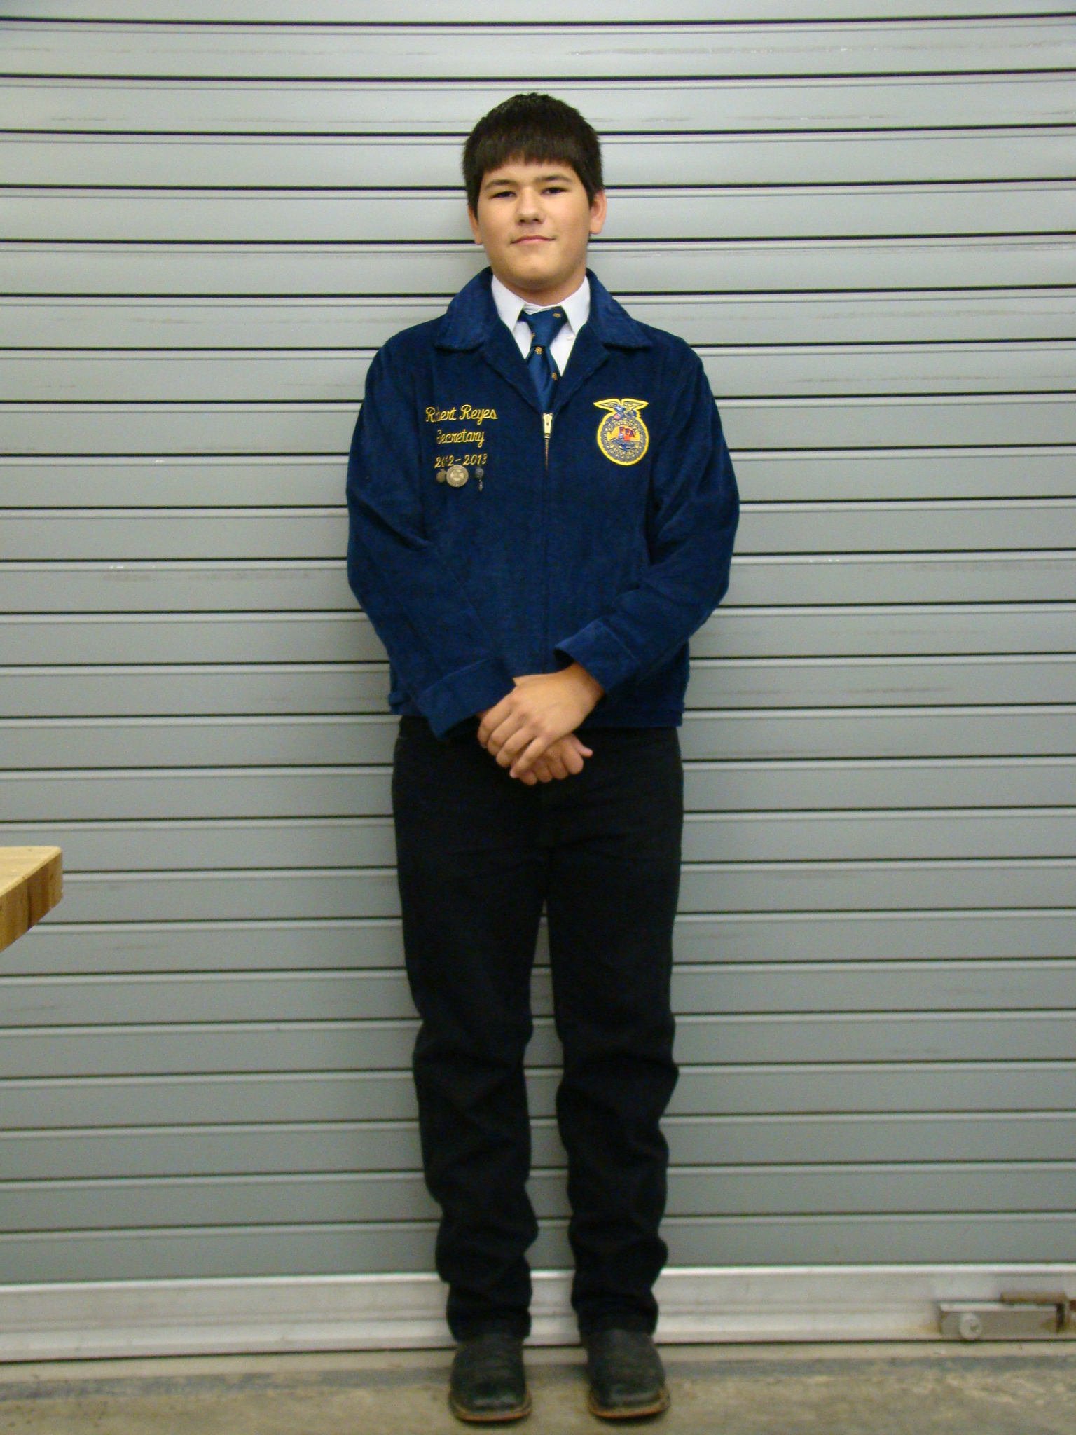

Slide 65
How to Wear Awards
Chapter degree, officer and award medals should be worn beneath the name of the right side of the jacket.
State FFA Degree or American Degree key should be worn above the name or attached to a standard key chain.
No more than 3 medals should be worn on the jacket. These should represent highest degree earned, highest office held and the highest award earned.

Slide 66
Career Development Events Leadership Development Events
Agricultural Communications
Agricultural Issues Forum
Agricultural Sales
Agricultural Technology & Mechanical Systems
Agronomy
Conduct of Chapter Meetings Leadership Development
Creed Speaking
Dairy Cattle Evaluation & Management
Dairy Cattle Handlers Activity
Environmental & Natural Resources
Extemporaneous Public Speaking
Farm Business Management
Floriculture
Food Science & Technology

Slide 67
Career Development Events Leadership Development Events
Forestry
Horse Evaluation
Job Interview
Livestock Evaluation
Marketing Plan
Meats Evaluation & Technology
Milk Quality & Products
Nursery/Landscape
Parliamentary Procedure
Poultry Evaluation
Prepared Public Speaking
Veterinary Science

Slide 68
Your Opportunities
Career Development Events / Leadership Development Events
Supervised Agriculture Experiences
Conventions
Expos
Field Trips

